Slide 1
Lab 1 Design Review
OPERATING SYSTEMS
张远航 甘睿彤

Slide 2
Where to place the bootblock
“在MIPS 架构下，启动程序被放在了启动设备（U 盘，硬盘等）的第一个扇区，系统启动时该扇区被loadboot 自动加载在内存地址0xa0800000 处”

Slide 3
How to move kernel from disk to memory & Where to place the kernel in the memory
怎样从磁盘读内核？
PMON中的读盘函数
三个参数
读取字节数 512
SD卡内部偏移量 512 (bblk—kernel)
将内核放在内存什么位置？
读取目的地址（内存中） 默认0xa0800200
可能原因：bootblock占了512(200H)字节
其实是可以自己改的（见Makefile）

Slide 4
Where the kernel entry point is
“将内核读取在内存的0xa0800200 处，而kernel.c中main 函数的偏移地址为0x6c, 那么在bootblock.s 读完内核之后就需要跳转到0xa080026c 处执行”

Slide 5
可执行文件bootblock和kernel在内核镜像的什么位置存放？
image
/ \
bblk + kernel
512 512

Slide 6
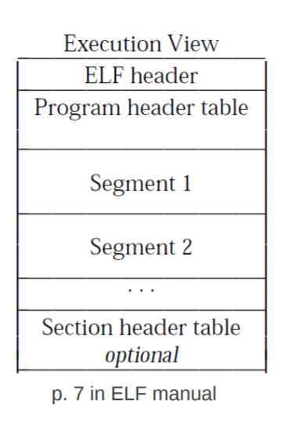
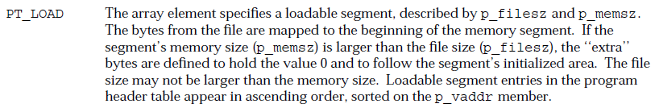
可执行文件(ELF)的特点？怎样读取可执行文件？
read in ELF header
read each program header
Executable segments: p_type == PT_LOAD

Slide 7
How to create image
利用ELF头信息找到首个代码段
assuming at least one program i.e. e_phnum > 0
1st program occurs at (Program Header Start Offset + Num headers * Program Header Size): e_phoff + e_phentsize
这一代码段应当放在image的什么位置？
Sec 2.1, "Base Address" section of ELF documentation
“To compute the base address, one determines the memory address associated with the lowest p_vaddr value for a PT_LOAD segment. One then obtains the base address by truncating the memory address to the nearest multiple of the maximum page size.”

Slide 8
How to create image (cont’d)
需要做padding
force padding by writing p_memsz > p_filesz
at the end, pad to nearest sector

